Slide 1
Machine Learning Workshop
GLEON 19 November 27, 2017

Slide 2
From a comment thread on Andrew Gelman’s blog:
Simon Blomberg says:
From R's fortunes package:
To paraphrase provocatively, 'machine learning is statistics minus any checking of models and assumptions'.
— Brian D. Ripley (about the difference between machine learning and statistics) useR! 2004, Vienna (May 2004)
:-)
Season's Greetings!
Simon.
Andrew Gelman says:
Simon,
In that case, maybe we should get rid of checking of models and assumptions more often. Then maybe we'd be able to solve some of the problems that the machine learning people can solve but we can't!

Slide 3
What Is Machine Learning
Computer “learns”:
More input, more learning.
Prediction (regression), classification (cat?)
Contrast: Data mining
Focuses on explanatory patterns.
Done by person.
Contrast: Statistics
ML is more algorithmic/computational.
ML less concerned with provable quantification/properties.

Slide 4
Types of ML
Supervised learning:
Labelled training set: Observations plus ground truth.
Example: Met drivers plus templine observations
Example: Labelled images.
Example: Heart disease?
Classification:
Cat?
Heart disease?
Regression/prediction:
Stock market
Temperature

Slide 5
Unsupervised learning: “Here’s some data. Is there anything interesting?”
Finding clusters
Are there “types” of lakes? (Phases, tipping points, etc.)
Chaotic attractors of dynamic systems
Reinforcement learning:
Like how a baby learns.
Can decide what to try.
If it “works”, positive reinforcement.

Slide 6
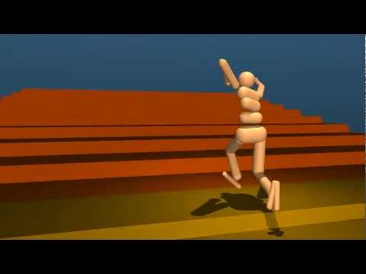
Emergence of Locomotion Behaviours in Rich Environments, DeepMind

Slide 7
How Do We Evaluate?
Divide data set into training data and test data.
Train the model on the training data.
Test on the test data.

Slide 8
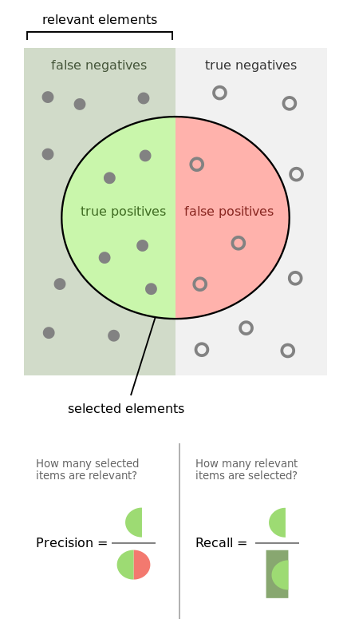
Precision and Recall
Precision: % of the found positives that are true.
Recall: % of true positives that were found.
By Walber - Own work, CC BY-SA 4.0, https://commons.wikimedia.org/w/index.php?curid=36926283

Slide 9
Confusion Matrix
 |  | Actual class
 |  | Cat | Dog | Rabbit
Predicted class | Cat | 5 | 2 | 0
 | Dog | 3 | 3 | 2
 | Rabbit | 0 | 1 | 11

Slide 10
Parameters vs Hyperparameters
Parameters are the coefficients, for example in a regression.
Hyperparameters control the model:
Degree of the polynomial
Number of neurons
As with statistics, ML may be parametric or non-parametric:
Parametric: Number of parameters controlled by hyperparameter.
Non-parametric: Number of parameters depend on size of training data.
Notes:
Non-parametric basically is kind of like a dynamic model.

Slide 11
Overfitting
Slides borrowed from “Statistics for Hackers”, Jake VanderPlas, PyCon 2016

Slide 12


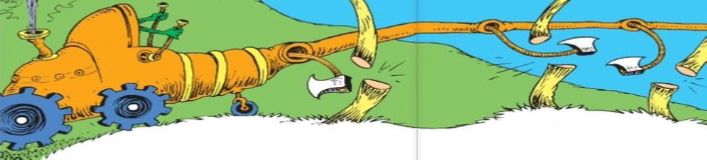


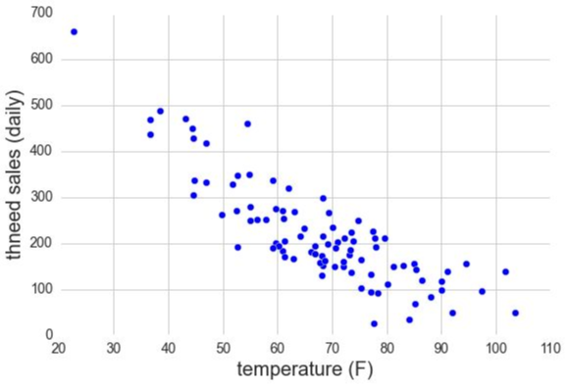

Thneed sales seem to show a
trend with temperature . . .

Slide 13
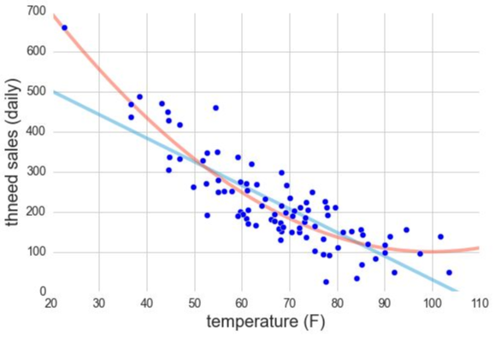

But which model is a better fit?
y = a + bx
y = a + bx + cx
2

Slide 14

Can we judge by root-mean-
square error?
RMS error = 63.0
RMS error = 51.5
y = a + bx
y = a + bx + cx
2

Slide 15
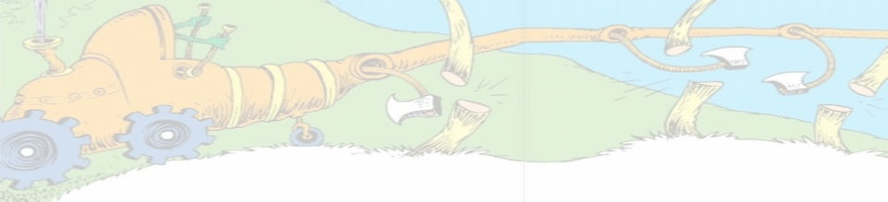


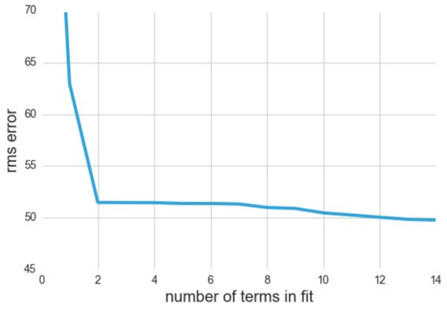

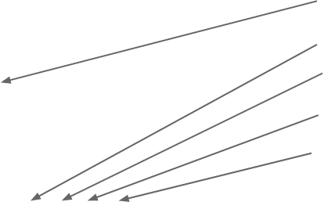
In general, more flexible models will
always have a lower RMS error.
y = a + bx
y = a + bx + cx
2
2
3
y = a + bx + cx + dx
2
3
4
y = a + bx + cx + dx + ex
y = a +
⋯

Slide 16


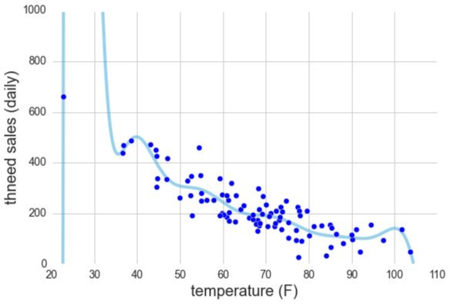
RMS error does not
tell the whole story.
2
3
4
5
⋯ + nx
14
y = a + bx + cx + dx + ex + fx +

Slide 17

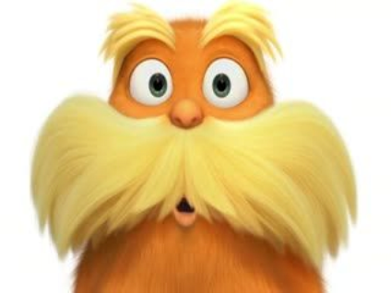

Not to worry:
Statistics has figured this out.

Slide 18
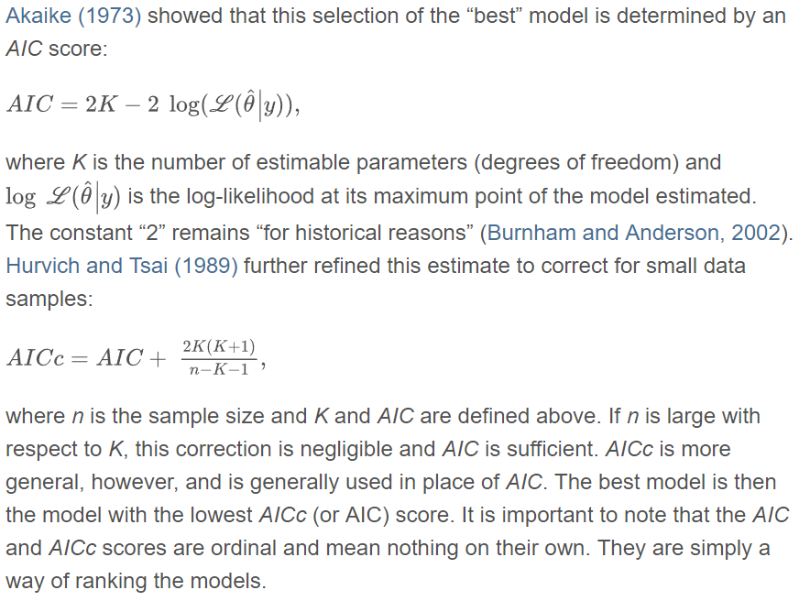
Akaike Information Criteria (AIC)

Slide 19

Uh, can I replace math with code?

Slide 20

Another Approach:
Cross Validation

Slide 21

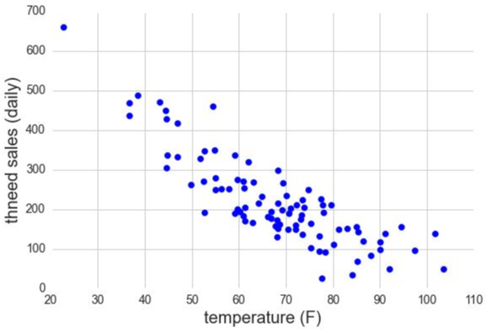
Cross-Validation

Slide 22

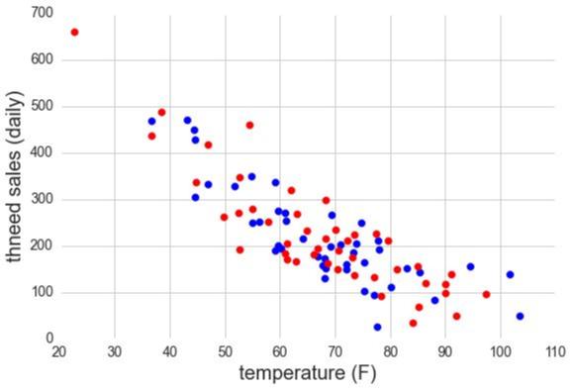
Cross-Validation
1. Randomly Split data

Slide 23

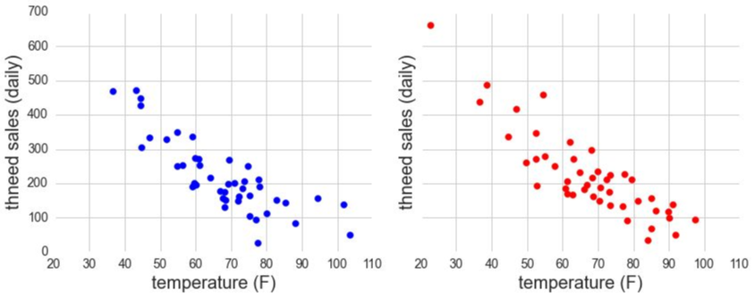
Cross-Validation
1. Randomly Split data

Slide 24

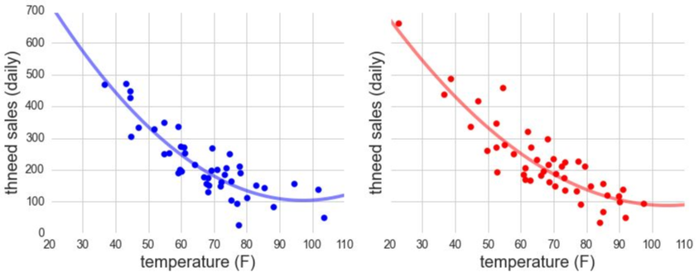
Cross-Validation
2. Find the best model for each subset

Slide 25

Cross-Validation
3. Compare models across subsets
Notes:
Compare right data to left model.

Slide 26
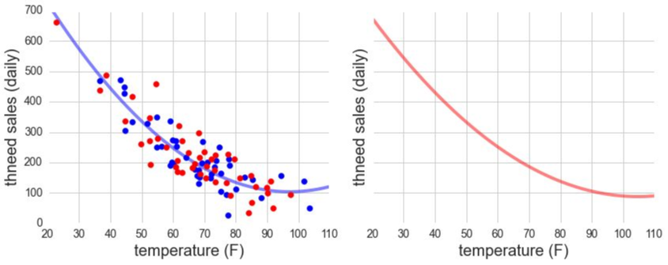
Cross-Validation
3. Compare models across subsets

Slide 27

Cross-Validation
3. Compare models across subsets

Slide 28
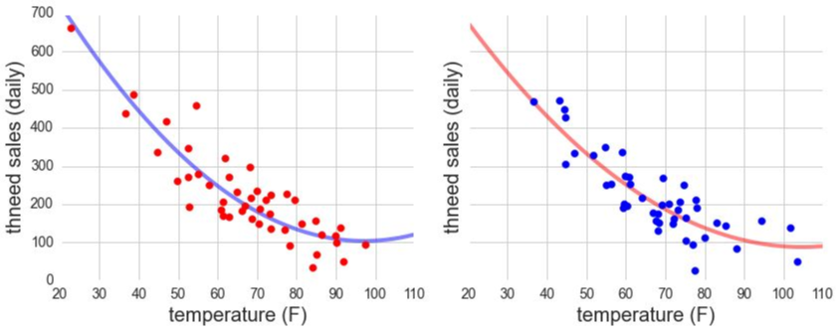
Cross-Validation
3. Compare models across subsets

Slide 29


Cross-Validation
4. Compute RMS error for each
RMS = 55.1
RMS = 48.9
RMS estimate = 52.1

Slide 30

Cross-Validation
Repeat for as long as
you have patience . . .

Slide 31

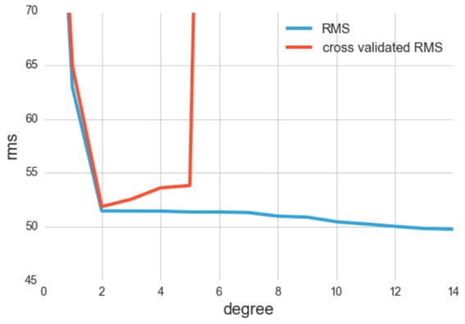
Cross-Validation
5. Compare cross-validated RMS for models:

Slide 32



Cross-Validation
5. Compare cross-validated RMS for models:
Best model minimizes the
cross-validated error.

Slide 33
Data used for cross-validation must come from training set, not test set.

Slide 34
Cluster Analysis

Slide 35
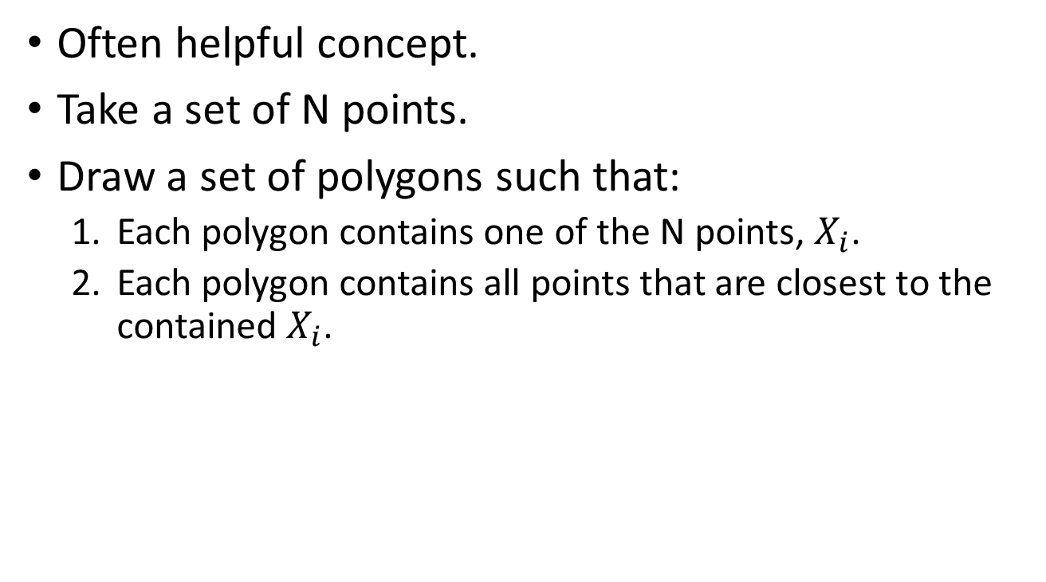
Voronoi Diagrams
Often helpful concept.
Take a set of N points.
Draw a set of polygons such that:
Each polygon contains one of the N points, $X_{i}$.
Each polygon contains all points that are closest to the contained $X_{i}$.

Slide 36
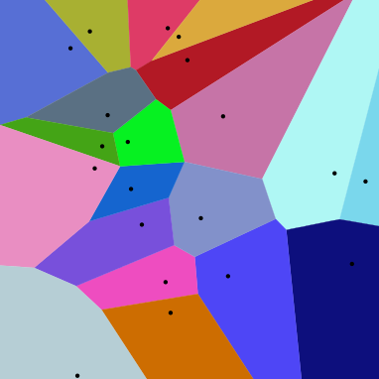
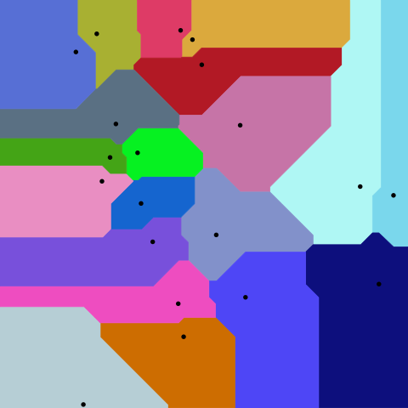
Euclidean distance
Manhattan distance
By Balu Ertl - Own work, CC BY-SA 4.0, https://commons.wikimedia.org/w/index.php?curid=38534275

Slide 37
Cluster analysis: Grouping similar objects together.
Can cluster based on “similarity”. Input is an NxN distance matrix.
Can cluster based on features. Input NxD feature matrix.
Clusters can be “flat”, or hierarchical.

Slide 38
Distance Measures
Squared Euclidean
Manhattan
Correlation coefficient (e.g. time series)
Categorical, code as 0 or 1, using Hamming

Slide 39
K-Means
Cluster into a fixed number of clusters: K
Goal is to minimize the sum squared distance of every point from the centroid of it’s cluster.
Exact is computationally intractable, but approximations exist.
Algorithm first picks cluster centers randomly.
Assign each point to nearest cluster.
Update center as centroid.
Repeat.
Visualization: http://stanford.edu/class/ee103/visualizations/kmeans/kmeans.html

Slide 40
Example: Old Faithful eruptions:
X-axis is the eruption duration.
Y-axis is time to the next eruption.
Initial cluster centers chosen randomly.
Pattern Recognition and Machine Learning, Bishop
Notes:
Figure 9.1 Illustration of the K-means algorithm using the re-scaled Old Faithful data set. (a) Green points
denote the data set in a two-dimensional Euclidean space. The initial choices for centres μ1 and μ2 are shown
by the red and blue crosses, respectively. (b) In the initial E step, each data point is assigned either to the red
cluster or to the blue cluster, according to which cluster centre is nearer. This is equivalent to classifying the
points according to which side of the perpendicular bisector of the two cluster centres, shown by the magenta
line, they lie on. (c) In the subsequent M step, each cluster centre is re-computed to be the mean of the points
assigned to the corresponding cluster. (d)–(i) show successive E and M steps through to final convergence of
the algorithm.

Slide 41
Pattern Recognition and Machine Learning, Bishop
Notes:
Figure 9.1 Illustration of the K-means algorithm using the re-scaled Old Faithful data set. (a) Green points
denote the data set in a two-dimensional Euclidean space. The initial choices for centres μ1 and μ2 are shown
by the red and blue crosses, respectively. (b) In the initial E step, each data point is assigned either to the red
cluster or to the blue cluster, according to which cluster centre is nearer. This is equivalent to classifying the
points according to which side of the perpendicular bisector of the two cluster centres, shown by the magenta
line, they lie on. (c) In the subsequent M step, each cluster centre is re-computed to be the mean of the points
assigned to the corresponding cluster. (d)–(i) show successive E and M steps through to final convergence of
the algorithm.

Slide 42
Hierarchical Clustering
Agglomerative: Each object starts in its own cluster.
Clusters are then merged, according to some criteria.
Example: Merged with nearest neighbor.

Slide 43
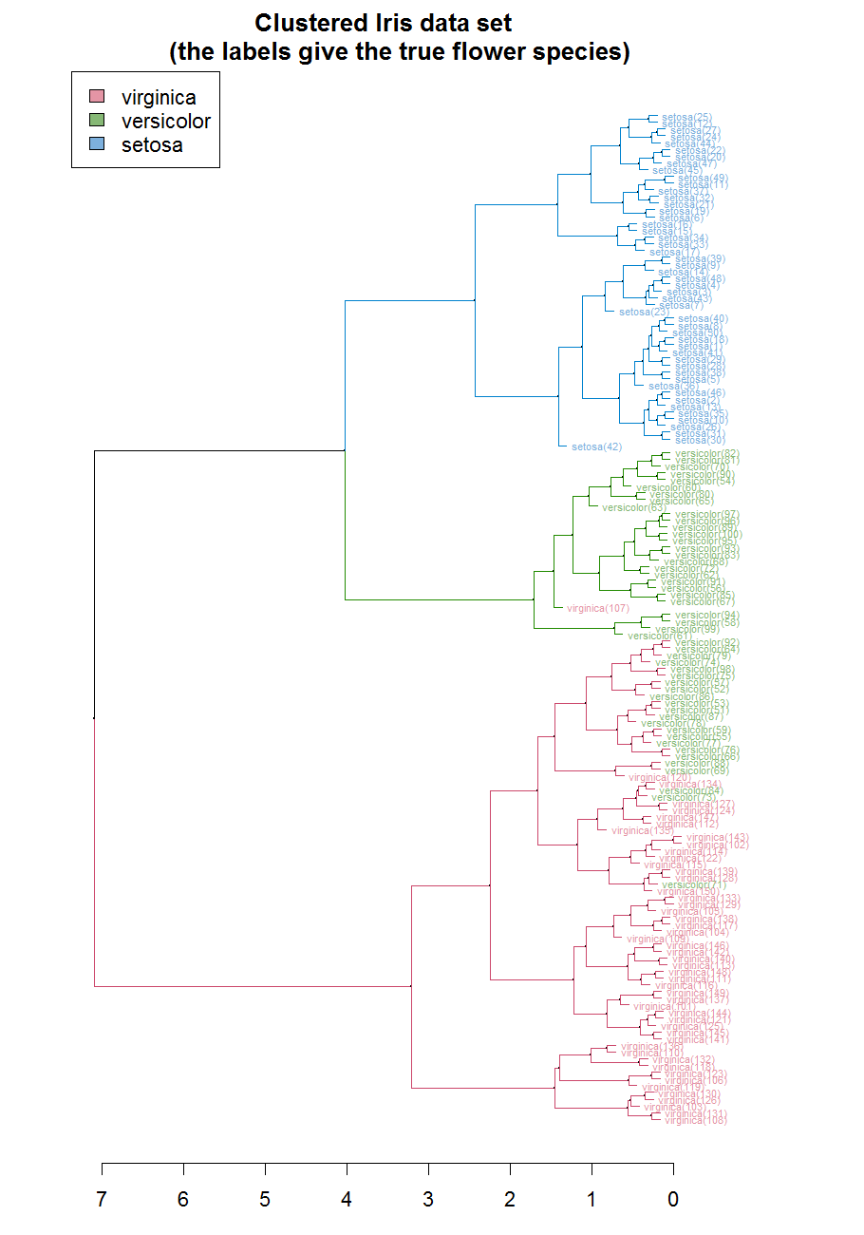

Slide 44
k Nearest Neighbors (k-NN)

Slide 45
Intuition: Objects with similar observables probably also have similar unobservables.
For classification:
Training set: N points with vector of features and labels.
To classify an X: Find N nearest neighbors. Class of X is the most common class of N.
For regression:
Training set: N points with vector of features, and the dependent variable y.
To predict an unknown: Find N nearest neighbors. y of X is the average of the nearest neighbors.

Slide 46
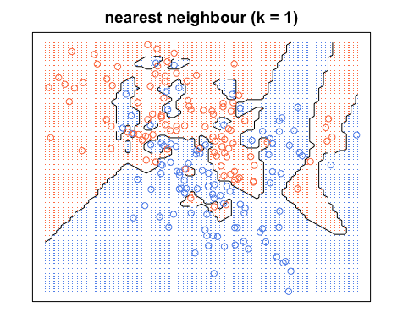
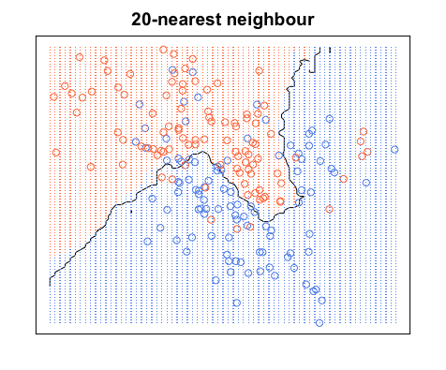
Choice of k
A large k basically smooths the boundary between regions.
Elements of Statistical Learning, Trevor and Hastie

Slide 47
Support Vector Machines

Slide 48
Intuition: If objects are plotted data points in some feature space, we can probably draw a line/curve dividing the regions.
SVMs leverage that idea. Finds the plane that separates the two classes with the largest margin.
Easy to see when in 2-D, but you can’t see it in, say, 6-D!

Slide 49
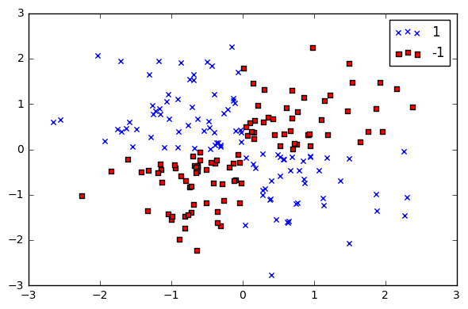
https://chrisalbon.com/machine-learning/svc_parameters_using_rbf_kernel.html

Slide 50
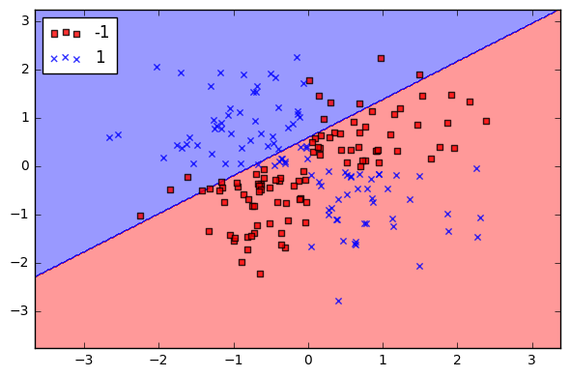
https://chrisalbon.com/machine-learning/svc_parameters_using_rbf_kernel.html

Slide 51
Kernels
A kernel is like the opposite of a distance metric.
Measures “similarity”.
Higher is more similar.
Can think of like a dot product.
Perpendicular vectors are very dissimilar, and have 0 dot product.
Linear kernels result in hyperplanes.
Other kernels result in curved boundaries.
Common one is radial basis function (RBF) kernel.

Slide 52
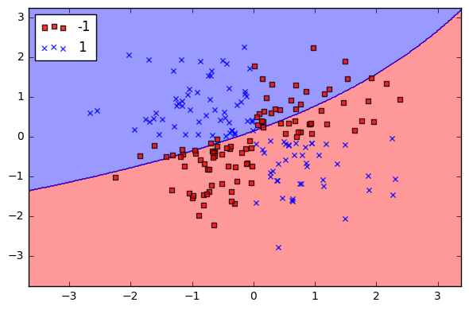
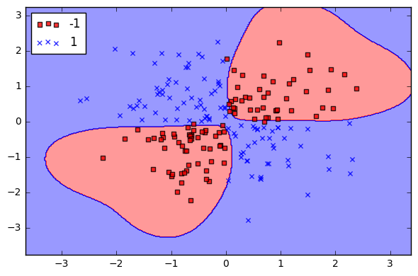
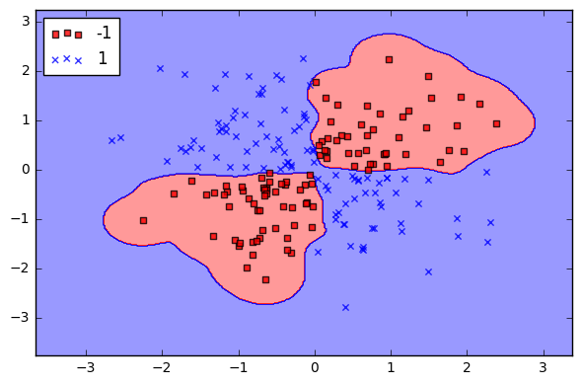
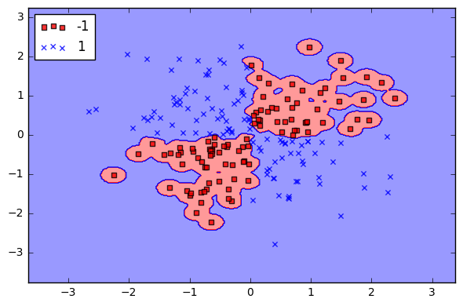
Gamma 0.1
Gamma 1
Gamma 10
Gamma 100
https://chrisalbon.com/machine-learning/svc_parameters_using_rbf_kernel.html

Slide 53
Cost Parameter
We don’t want to give outliers undue influence.
With a soft margin, using a cost parameter, misclassification in training set allowed.

Slide 54
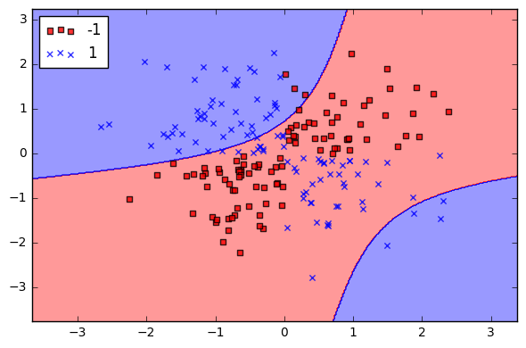
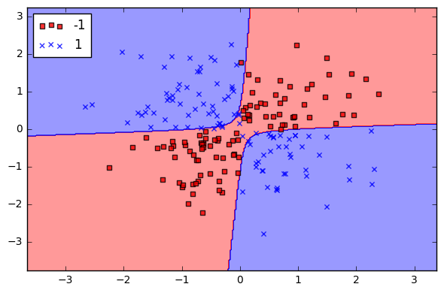

Cost 1
Cost 10
Cost 1000
Cost 10,000
https://chrisalbon.com/machine-learning/svc_parameters_using_rbf_kernel.html

Slide 55

Cost 10,000
Cost 100,000
https://chrisalbon.com/machine-learning/svc_parameters_using_rbf_kernel.html

